Slide 1



Credit Card Approval Prediction Project
This presentation outlines a machine learning project focused on predicting credit card approval for a financial institution. This project utilizes various machine learning techniques, including data exploration, feature engineering, model development, and evaluation, to build a robust predictive model. We aim to identify key factors influencing credit card approval decisions, build a model that accurately predicts outcomes, and provide valuable recommendations for enhancing the credit card application process.
by Divya Vaishnavi V

Slide 2
Project Overview
Data Acquisition and Preparation
1
The project starts with acquiring a dataset containing historical credit card application data. This dataset is then cleaned and preprocessed, handling missing values and transforming categorical variables.
2
Exploratory Data Analysis
A thorough exploratory data analysis (EDA) is performed to gain insights into the data distribution, relationships between variables, and potential patterns. This involves visualization techniques, summary statistics, and univariate and bivariate analysis.
Feature Engineering
3
Feature engineering techniques are applied to enhance the predictive power of the model. New features might be created by combining existing variables or utilizing domain knowledge to create more insightful features.
4
Model Selection and Training
Various machine learning algorithms are explored, including logistic regression, decision trees, random forests, and boosting algorithms, to identify the best-performing model for credit card approval prediction.
Model Evaluation and Validation
5
The selected model is evaluated using appropriate metrics like accuracy, precision, recall, F1-score, confusion matrix, and ROC AUC. This step ensures the model's robustness and generalization ability.
6
Prediction and Recommendations
The trained model is used to predict credit card approval for new applications and Recommend Services.

Slide 3
Exploratory Data Analysis (EDA)
Univariate Analysis
Bivariate Analysis
Business Findings
Examining the distribution of each individual feature using histograms, box plots, and frequency tables. This provides insights into the nature of each variable and potential outliers.
Investigating the relationships between different pairs of features using scatter plots, correlation matrices, and contingency tables. This helps identify potential correlations and dependencies.
Drawing conclusions and identifying patterns from the EDA. This could involve identifying significant features, uncovering potential biases, and understanding the key drivers of credit card approval.

Slide 4
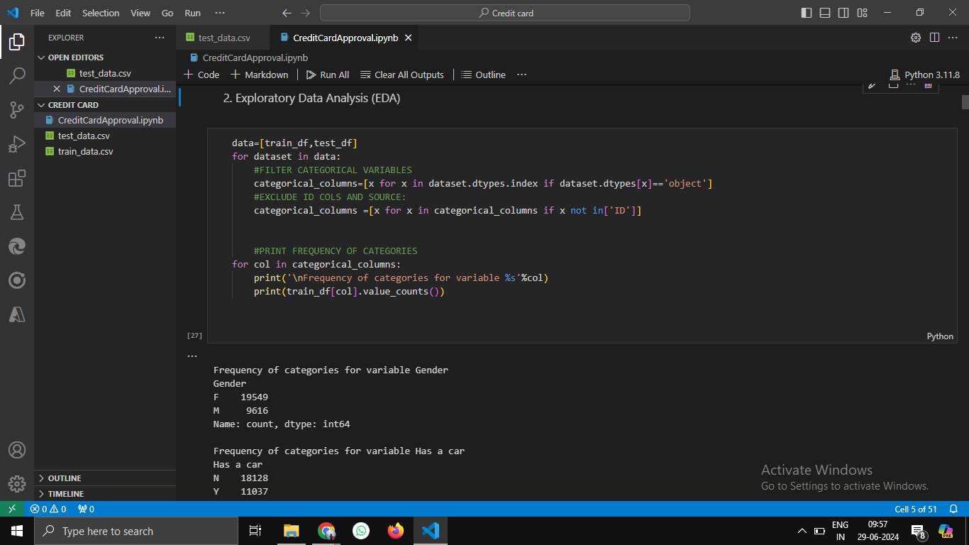
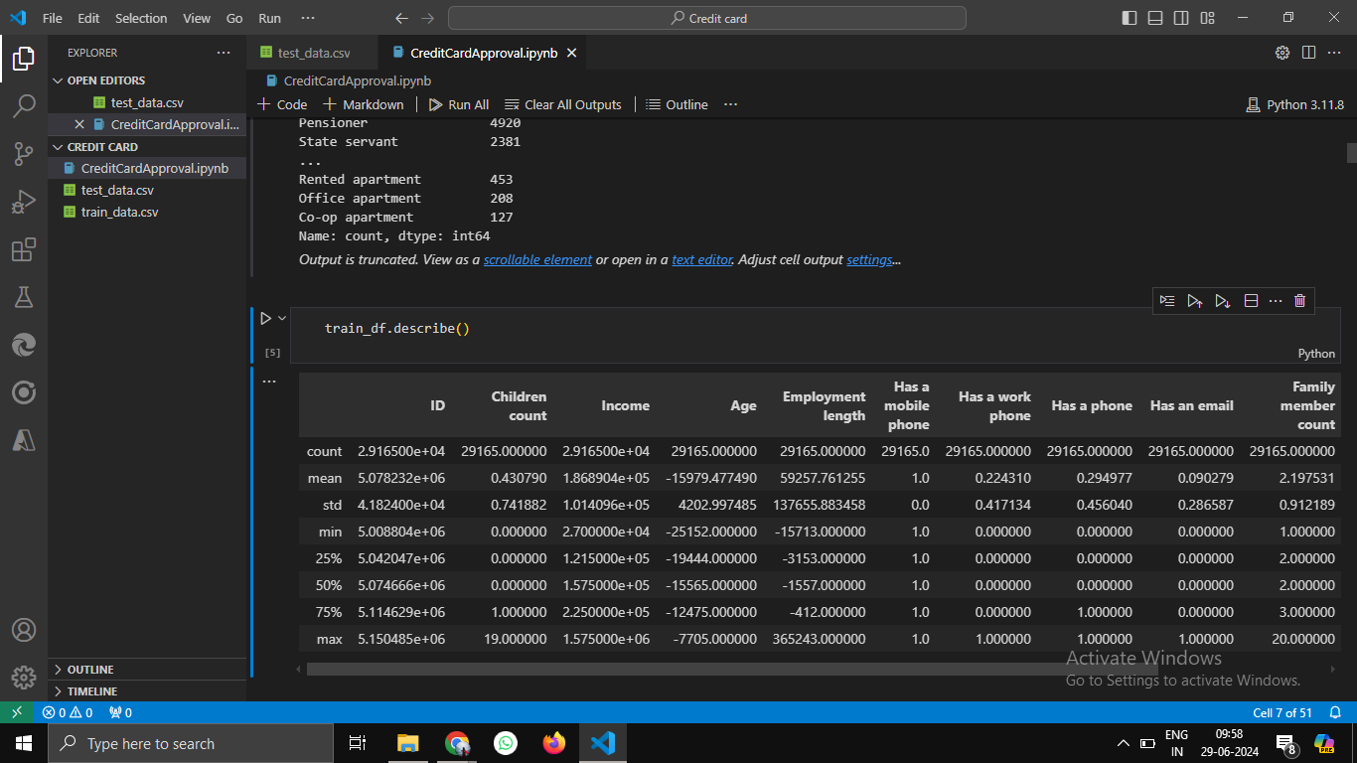

Slide 5
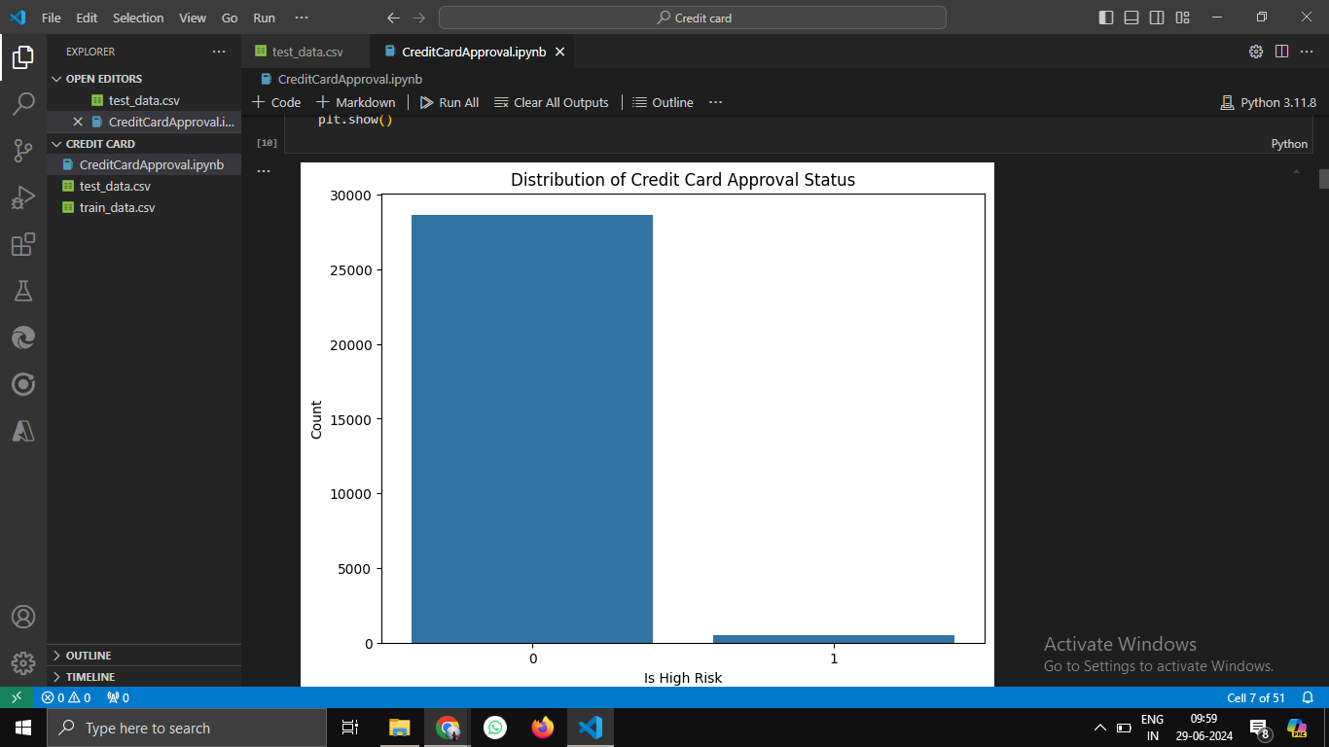
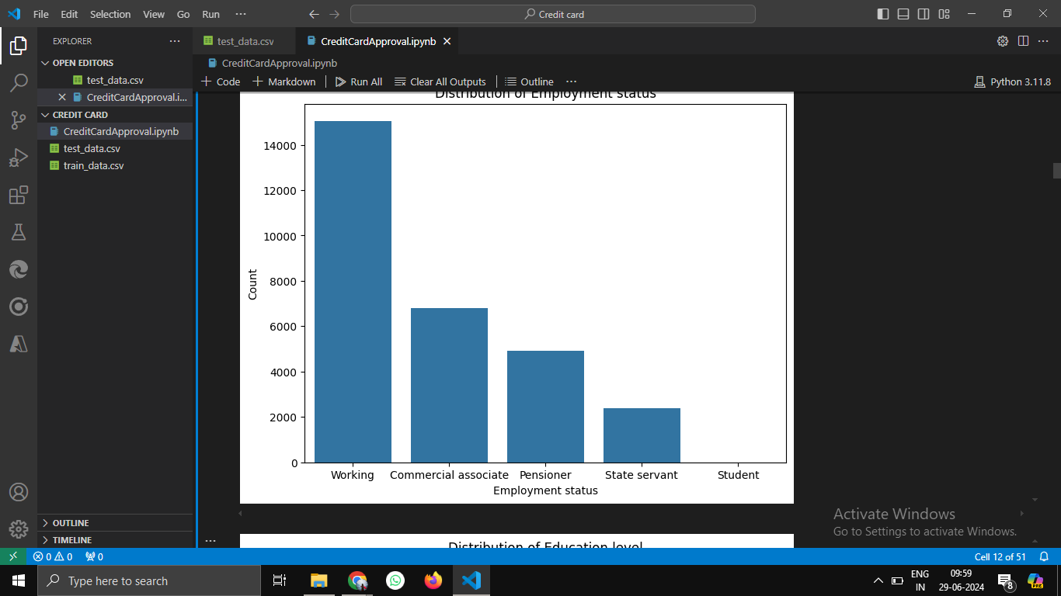

Slide 6
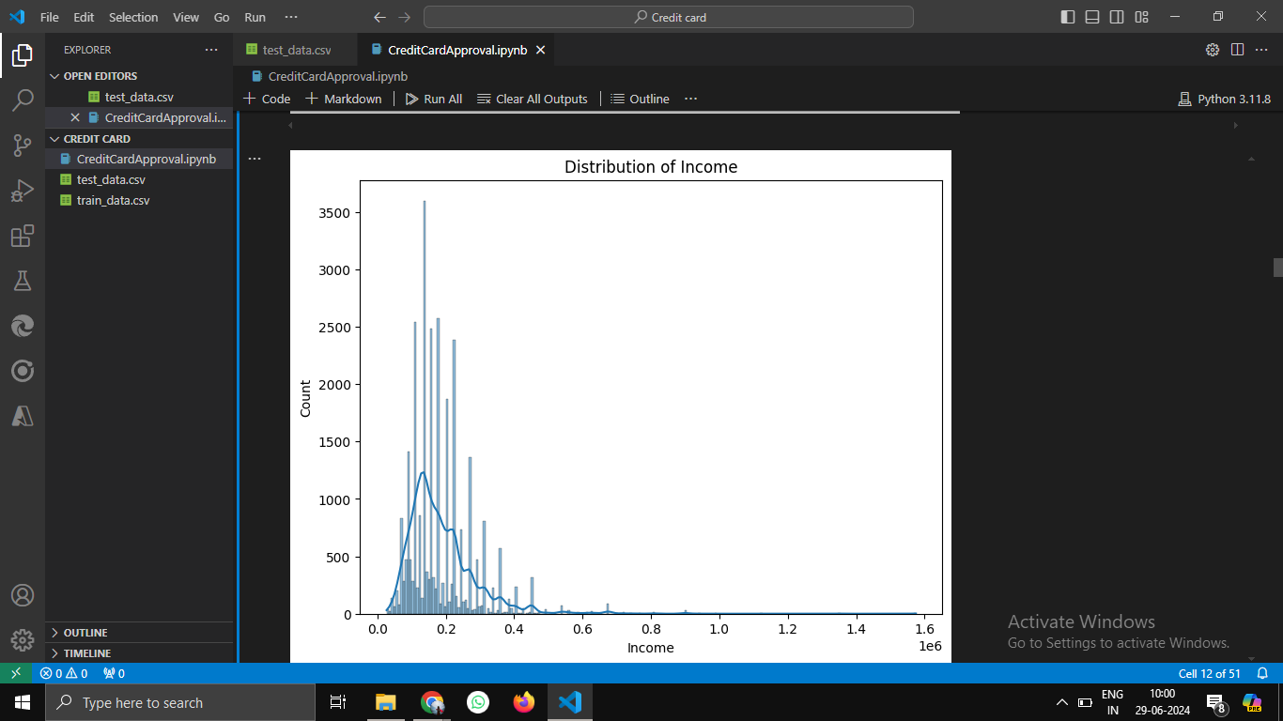
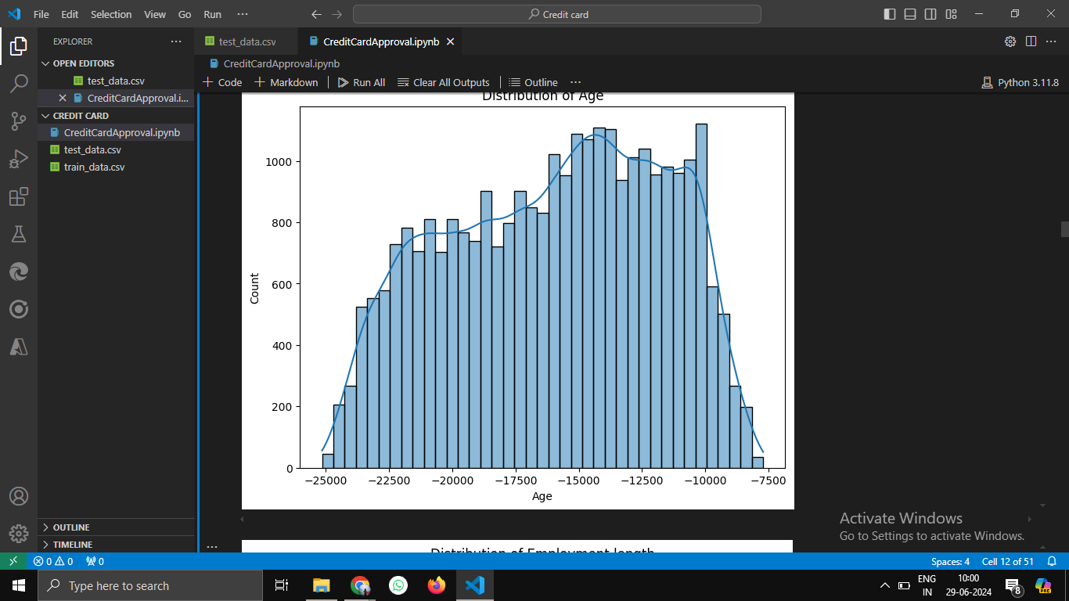

Slide 7
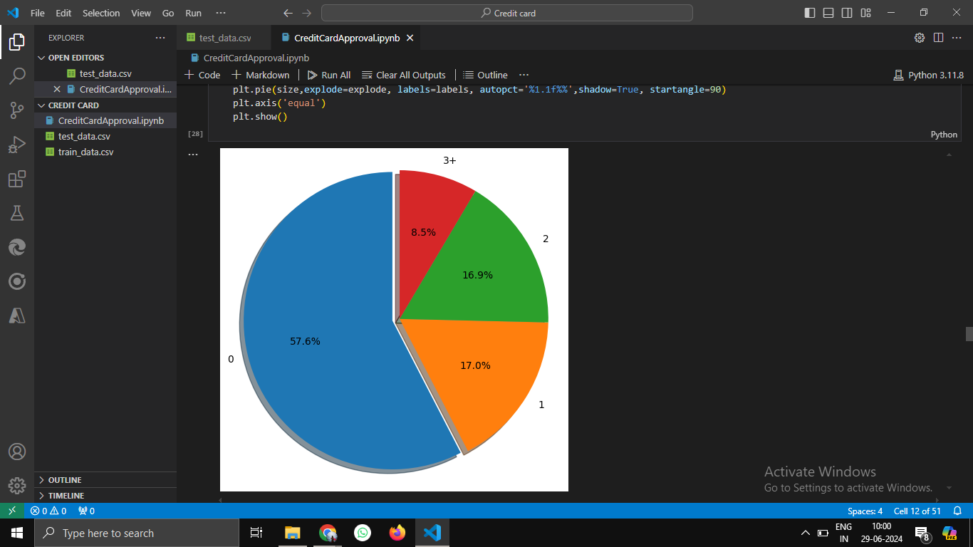
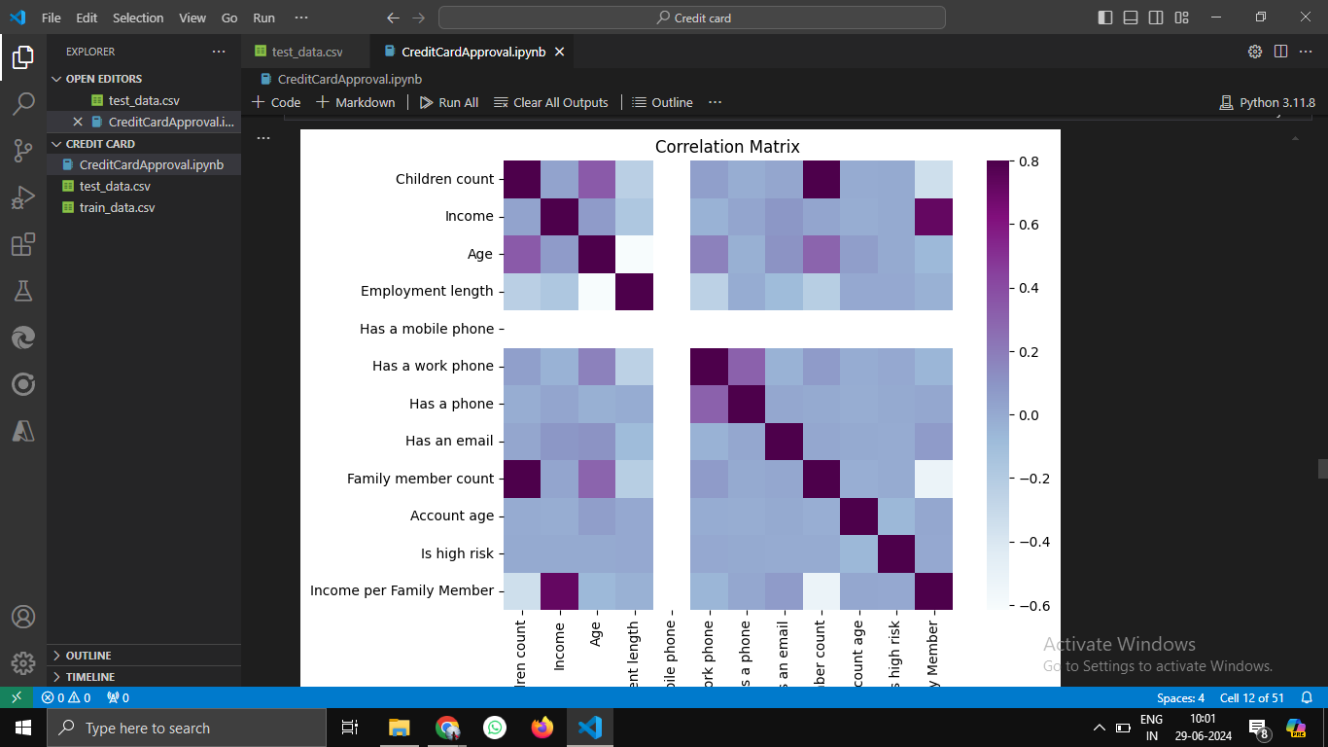

Slide 8


Feature Engineering
1
Feature Creation
Creating new features by combining existing variables. For example, combining income and age to create an "income-to-age ratio" feature.
2
Feature Transformation
Applying transformations to existing features to improve model performance. For instance, using logarithmic transformations to handle skewed distributions.
3
Interaction Terms
Creating interaction terms between relevant features to capture non-linear relationships. For example, the interaction between income and employment length could be informative.
4
Domain Expertise
Incorporating domain knowledge to create features specific to the credit card approval process. This could involve creating features based on credit score or debt-to-income ratios.

Slide 9
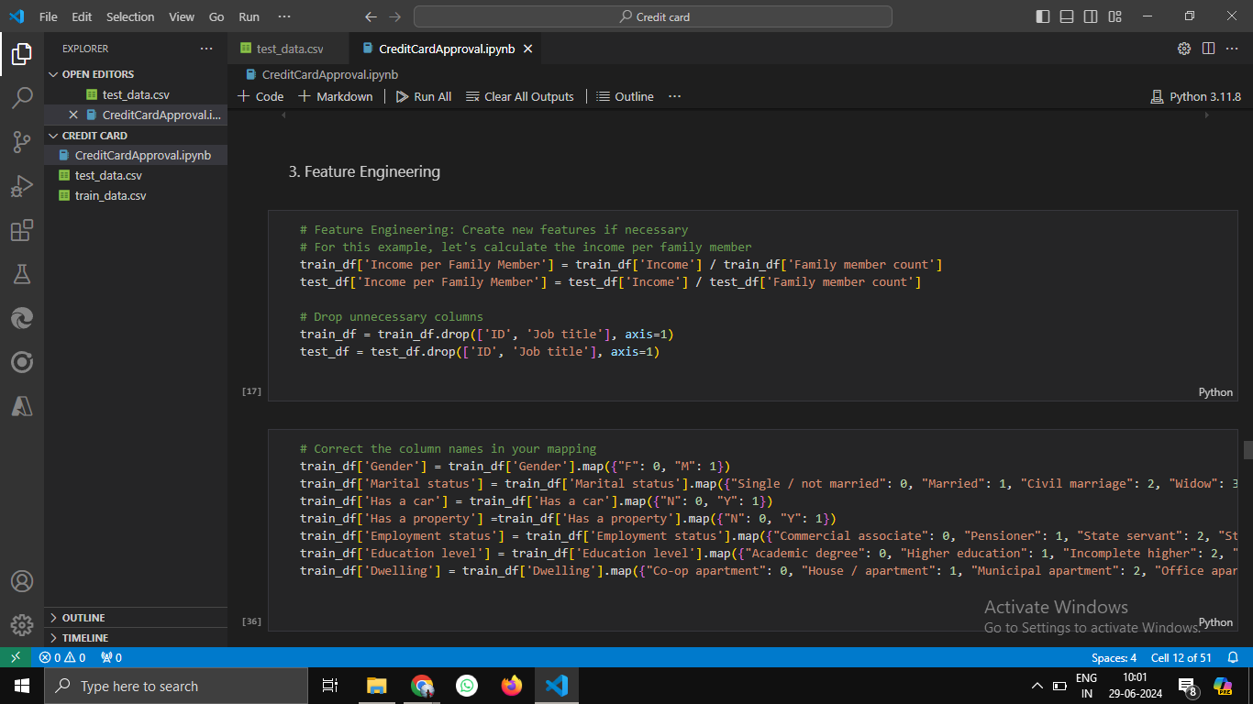
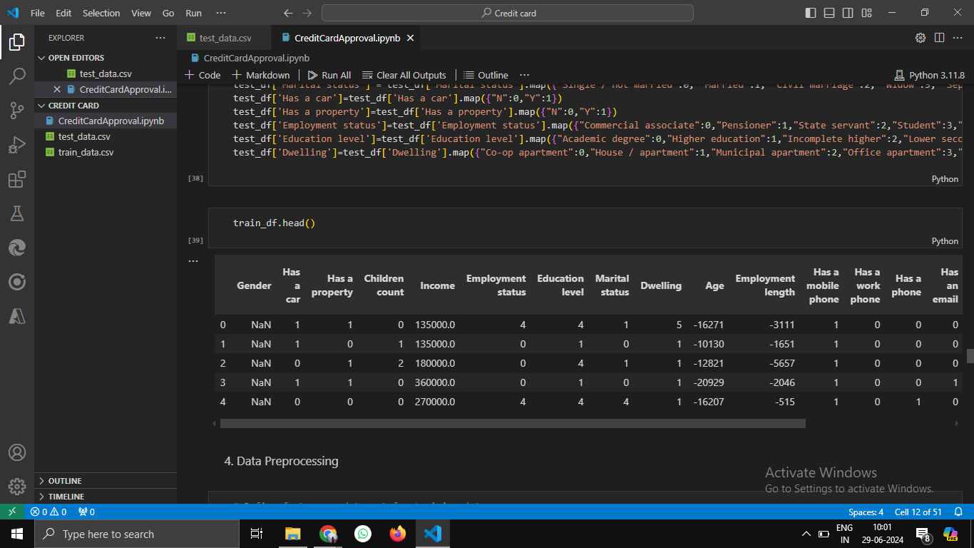

Slide 10

Data Preprocessing
Handling Missing Values
1
Imputing missing values using appropriate methods like mean imputation, median imputation, or more sophisticated techniques based on the nature of the missing data.
2
Encoding Categorical Variables
Converting categorical features into numerical representations using techniques like one-hot encoding, label encoding, or ordinal encoding, suitable for machine learning models.
Feature Scaling or Normalization
3
Scaling or normalizing features to ensure that they have a similar range, preventing features with larger scales from dominating the model's learning process.

Slide 11
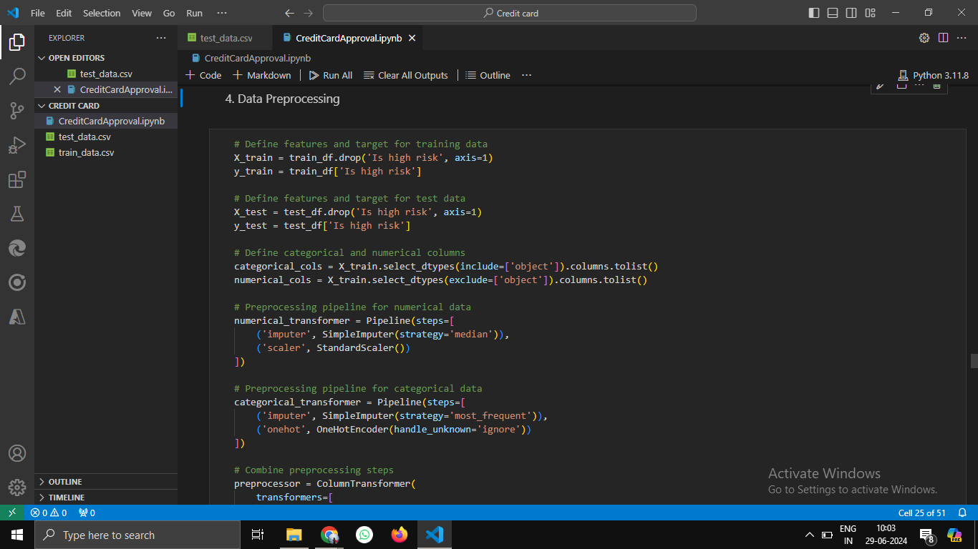
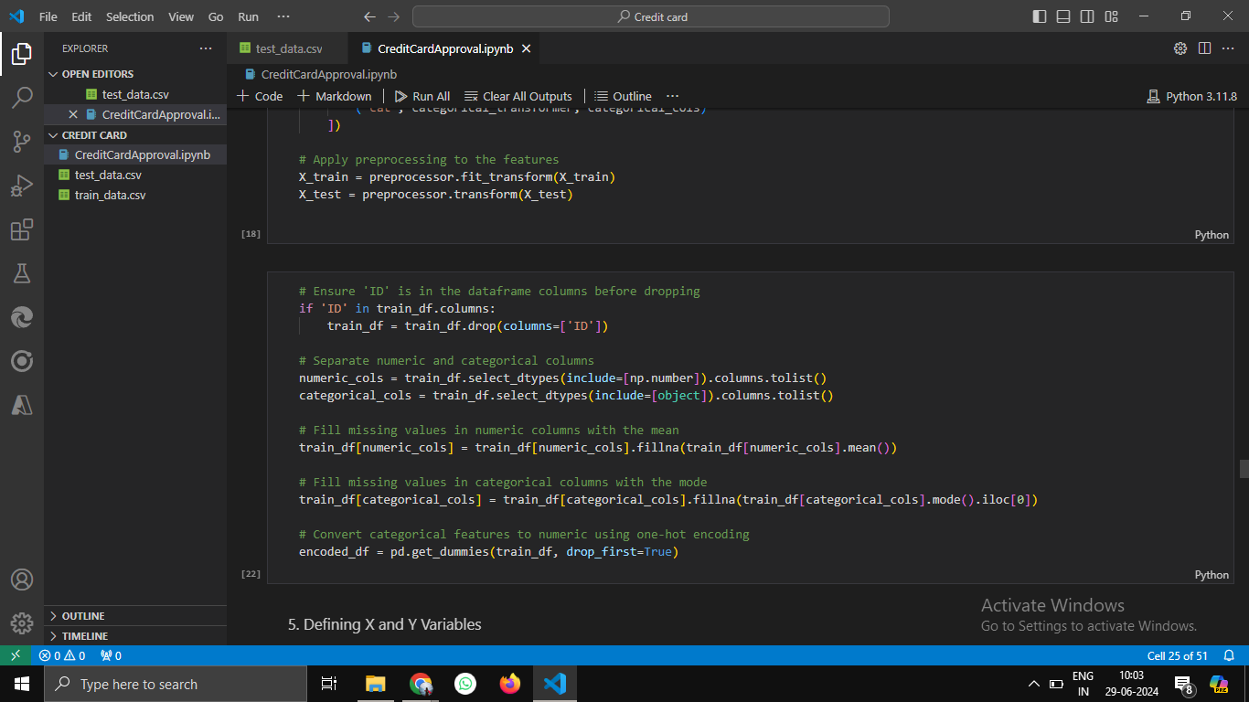

Slide 12

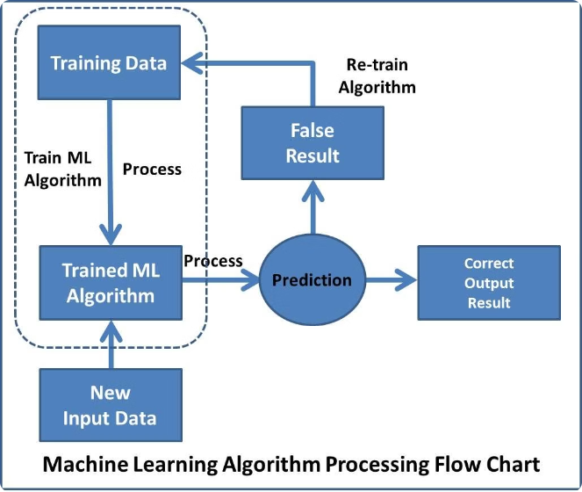
Machine Learning Model Development
Logistic Regression
A linear model that predicts the probability of an event (credit card approval) based on a set of features. It's a simple yet powerful algorithm for classification problems.
Decision Trees
Tree-based algorithms that partition the data based on feature values. They can create easily interpretable models, highlighting the key decision-making rules.
Random Forests
Ensemble learning technique that combines multiple decision trees to make predictions. This averaging approach often improves accuracy and robustness.
Boosting Algorithms
Algorithms like AdaBoost and Gradient Boosting iteratively build models by focusing on misclassified instances. They typically achieve high accuracy but may be more complex to interpret.

Slide 13
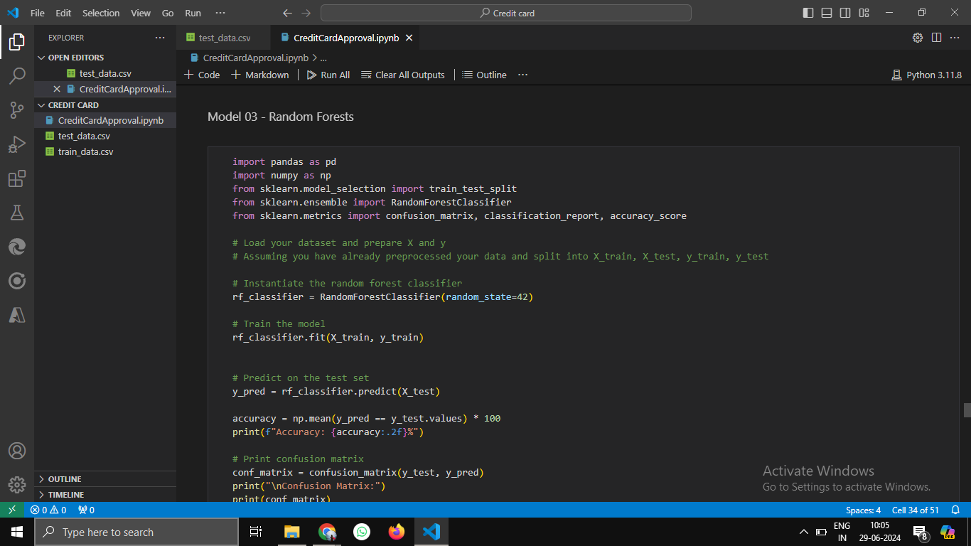
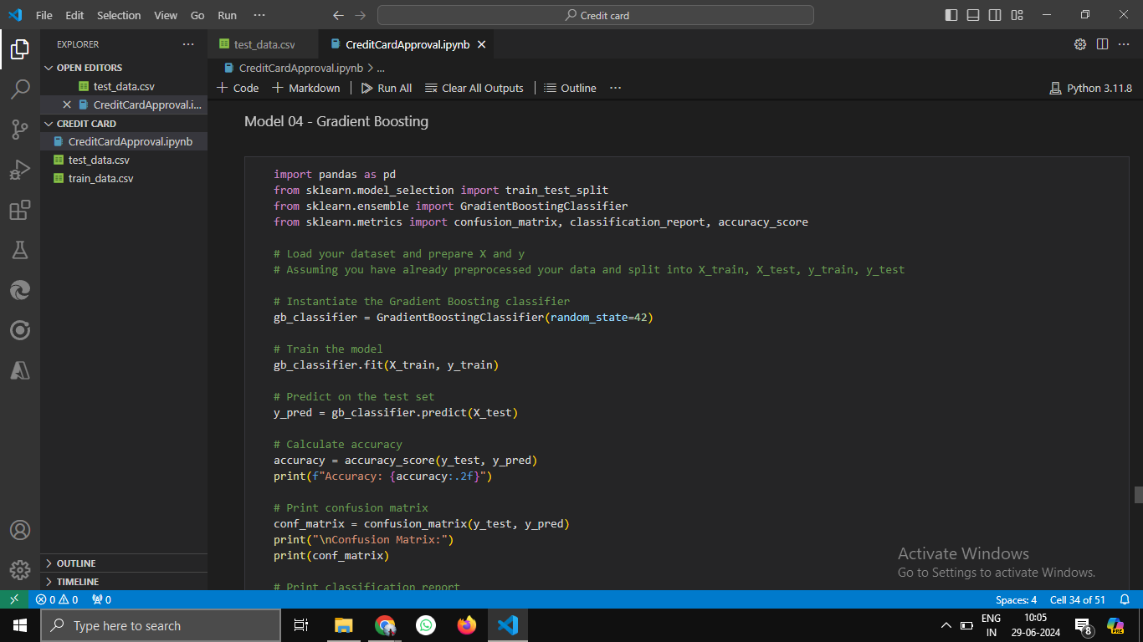

Slide 14
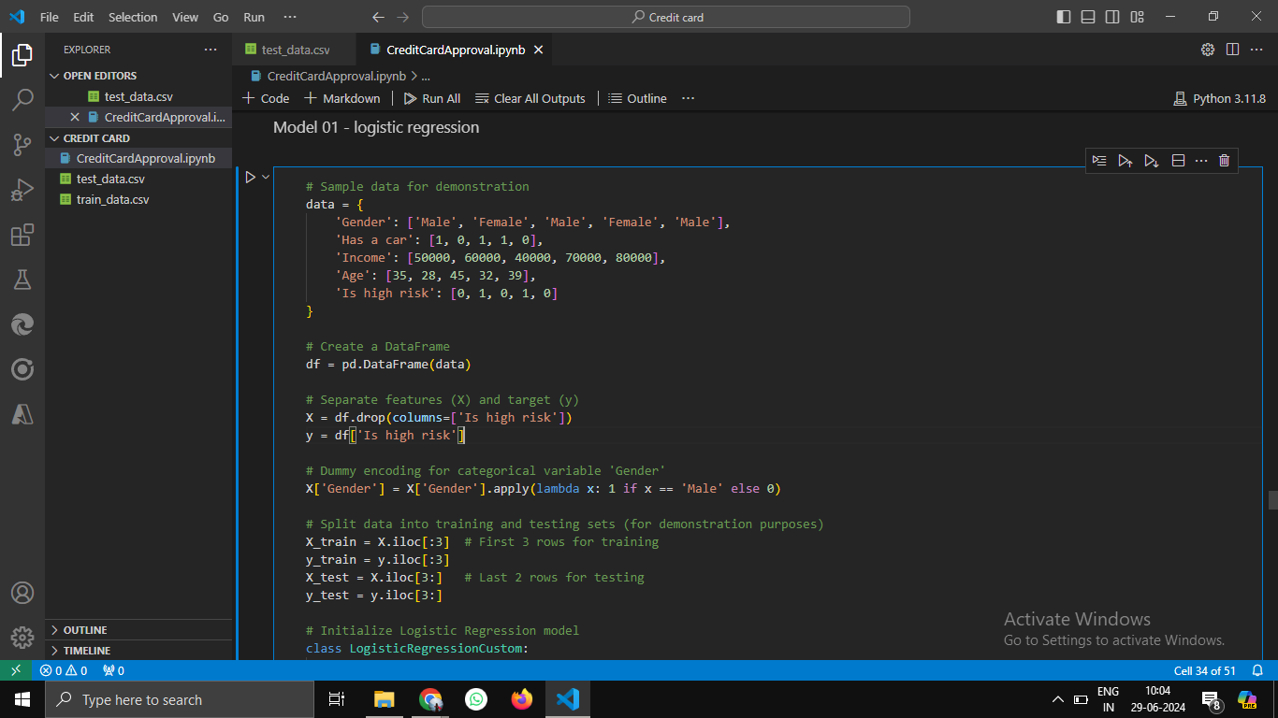
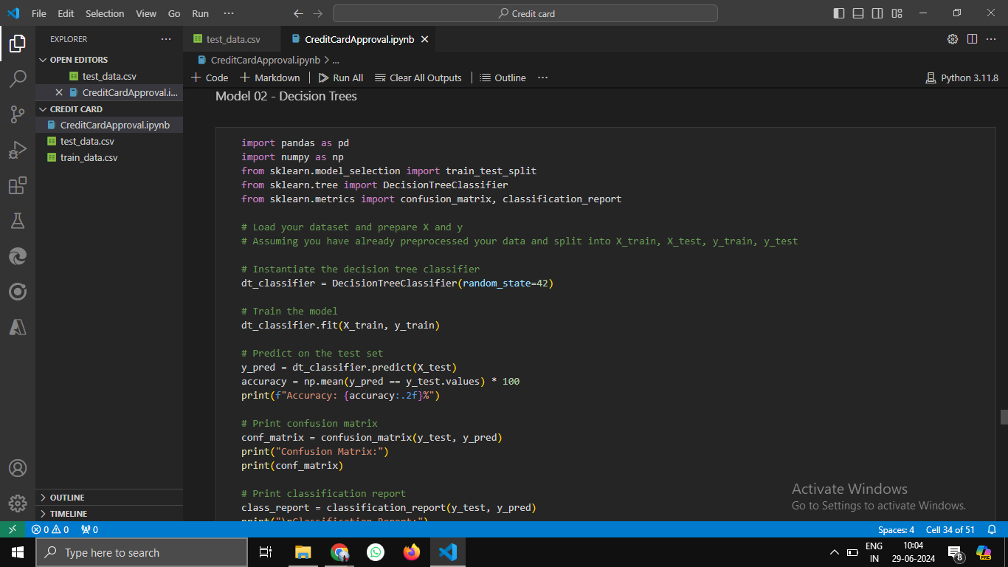

Slide 15

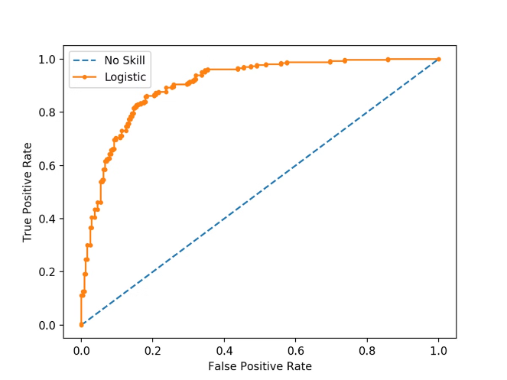
Model Evaluation
Metric
Description
Importance
Accuracy
The proportion of correctly classified instances.
Overall performance
Precision
The proportion of correctly predicted positive instances among all predicted positive instances.
False positive rate
Recall
The proportion of correctly predicted positive instances among all actual positive instances.
False negative rate
The harmonic mean of precision and recall.
F1-score
Balancing precision and recall
Confusion Matrix
A table that summarizes the classification performance by showing the number of true positives, true negatives, false positives, and false negatives.
Detailed performance analysis

Slide 16
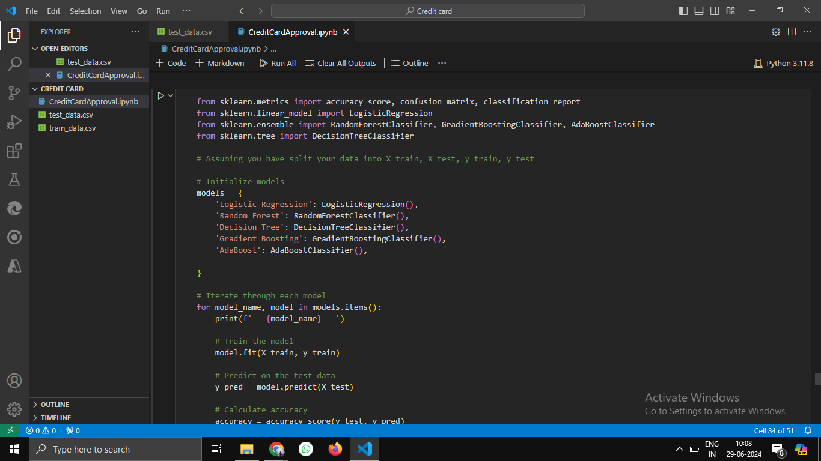
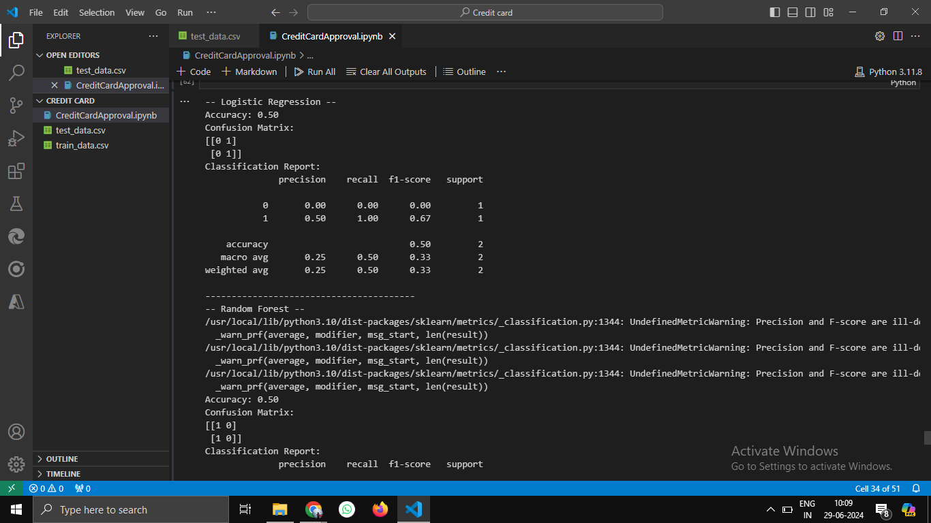

Slide 17
Best Model Selection:
Based on the provided metrics, Gradient Boosting appears to be the best model for predicting salaries. It achieved a perfect accuracy of 1.00, correctly classifying both instances in the test set. This indicates that Gradient Boosting was able to generalize well to the test data and predict both salary categories accurately.
When selecting the best model, consider other factors such as computational efficiency, interpretability, and potential overfitting. If computational efficiency and interpretability are important, Logistic Regression or Decision Tree might still be viable choices despite their lower accuracy in this case.

Slide 18





Predicting Credit Card Approval
Test Dataset
The trained gradient boosting model is used to predict credit card approval for unseen data from the test dataset, simulating real-world application scenarios.
Feature Importance
The feature importance scores provided by the gradient boosting model reveal the relative importance of each feature in predicting credit card approval. This helps understand which factors are most influential in the decision-making process.
Model Interpretation
Analyzing the feature importance scores and the model's predictions provides insights into the credit card approval process. This understanding helps identify factors that are driving positive or negative approval decisions.

Slide 19
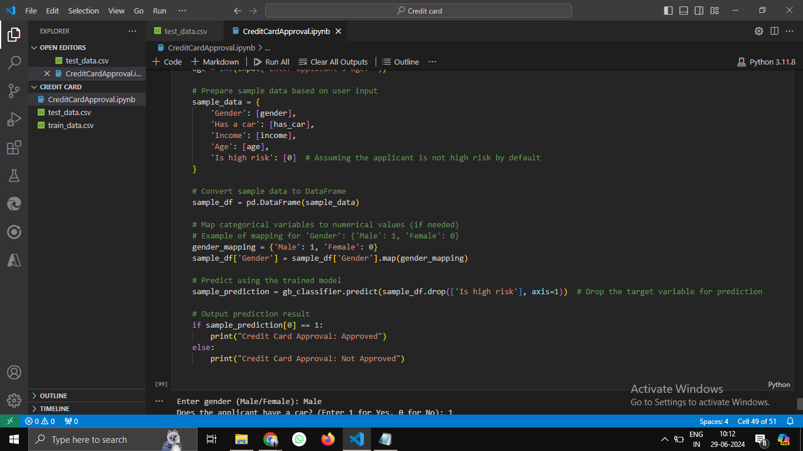

Slide 20
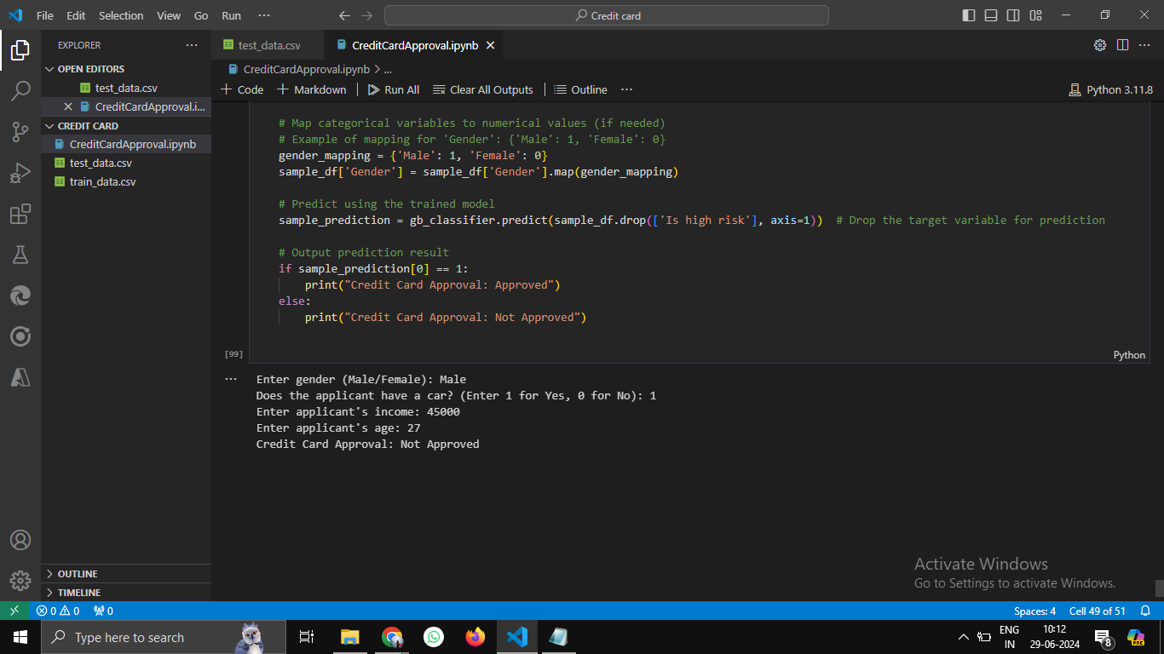

Slide 21






Recommendations
Risk Management
Based on the model's insights, identify high-risk applicant profiles and develop strategies to mitigate risk, such as stricter verification procedures or credit limit adjustments.
Targeted Marketing
Leverage the model's insights to identify potential high-value customers based on features that predict positive approval outcomes. This allows for targeted marketing campaigns to attract and convert promising applicants.
Process Optimization
Streamline the credit card application process by focusing on the most influential features identified by the model. This can involve simplifying the application form or prioritizing key data points for review.
Continuous Monitoring
Implement a monitoring system to track the model's performance over time and adapt the model as needed based on changes in the data or the credit card approval landscape.

Slide 22


Conclusion
This project successfully demonstrates the power of machine learning in predicting credit card approval outcomes. The process involved meticulous data exploration, feature engineering, model development, and rigorous evaluation, leading to the identification of key factors influencing credit card approvals. By leveraging the insights from this project, financial institutions can enhance their risk management strategies, optimize their credit card approval process, and improve their overall customer experience.

